Slide 1


Master’s Degree in Engineering in Computer Science Sapienza University of Rome Academic Year 2021-2022
Project Presentation for Data Management
Course: Data Management
Professor: Prof. Lenzerini Maurizio
Candidate: Carmignani Federico
ID number: 1845479
E-mail: carmignani.1845479@studenti.uniroma1.it

Slide 2

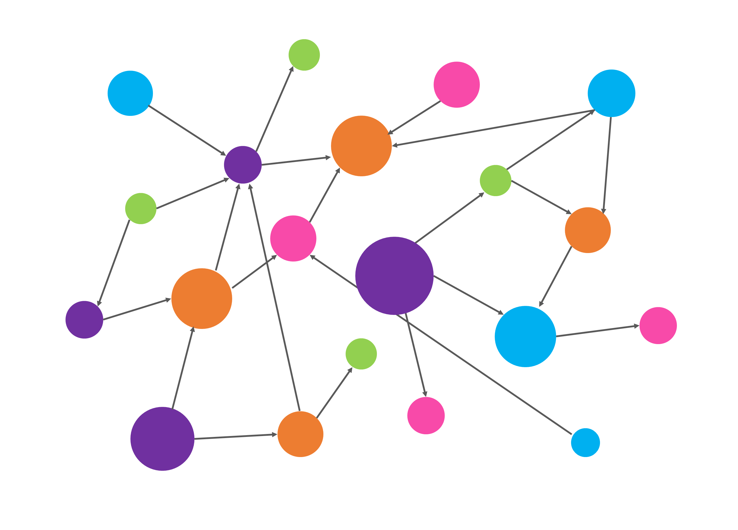
GRAPH DATABASES in FOOTBALL ANALYSIS
“How graphs are used in Sports?”
Data Management
Carmignani Federico 1845479

Slide 3
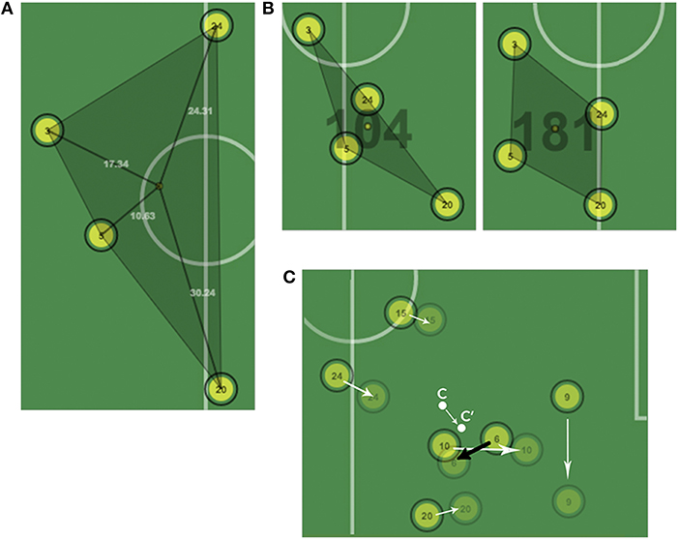
INDEX
Sports Professional Analysis:
Graph Databases
Experiments:
Applications to Football Analysis and a quick Demo
Tool:
Neo4j and its usage
Dataset:
Composition and Content
OUR GOAL
Take a NoSQL database showing a relevant usage of them over the selected dataset.
Data Management
Carmignani Federico 1845479

Slide 4

GRAPH DATABASES IN SPORTS ANALYSIS A FACTOR OF GROWTH
Graph databases will drive the next generation of:
Sports Analytics
Data Science
«Moneyball» by Michael Lewis as
an inspiration story
Data Management
Carmignani Federico 1845479

Slide 5


VS
Money
Analysis
IMPROVEMENT
Analytics are now important in Sport Analysis.
Private Departments in Sports team: Football, Basketball and many others.
The goal is to adopt behaviours or actions leading to higher probability of success or anticipating scenarios with the aim of strategy.
Data Management
Carmignani Federico 1845479

Slide 6
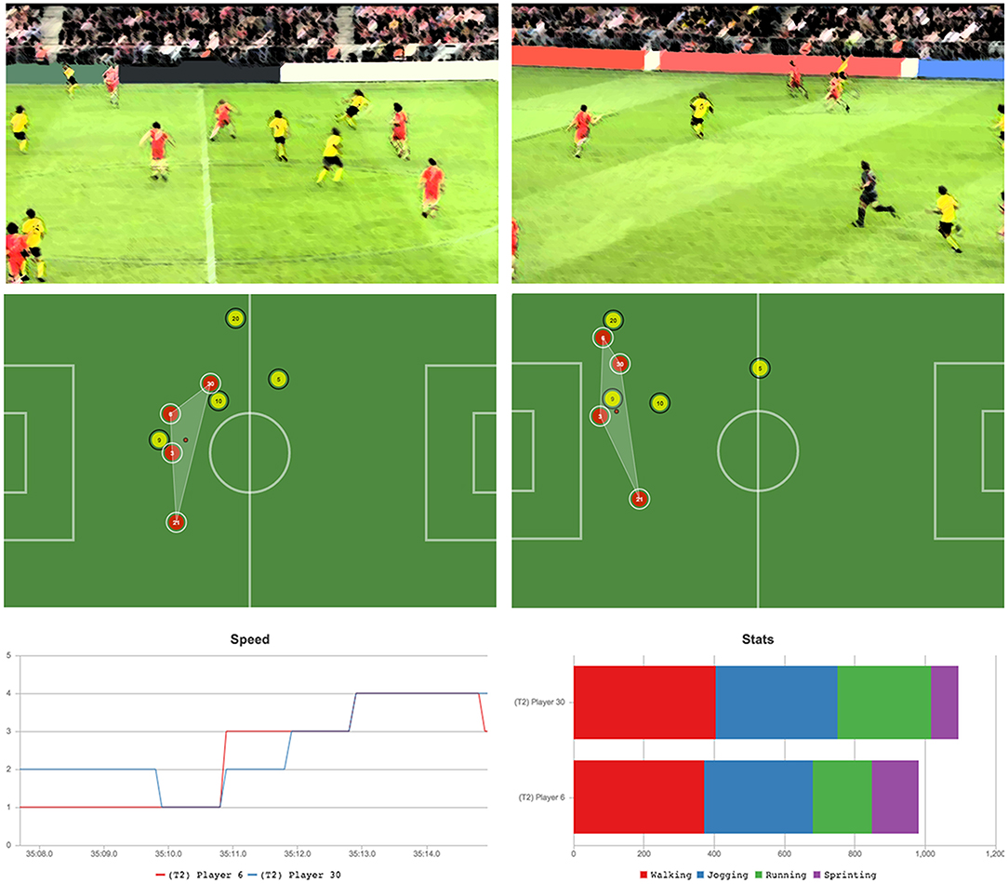
WHY GRAPH DATABASES IN SPORT ANALYTICS?
Organization
Interaction
Extraction of Value
Improving in Sports Data
Event-based
Temporal relevance
Data Management
Carmignani Federico 1845479

Slide 7

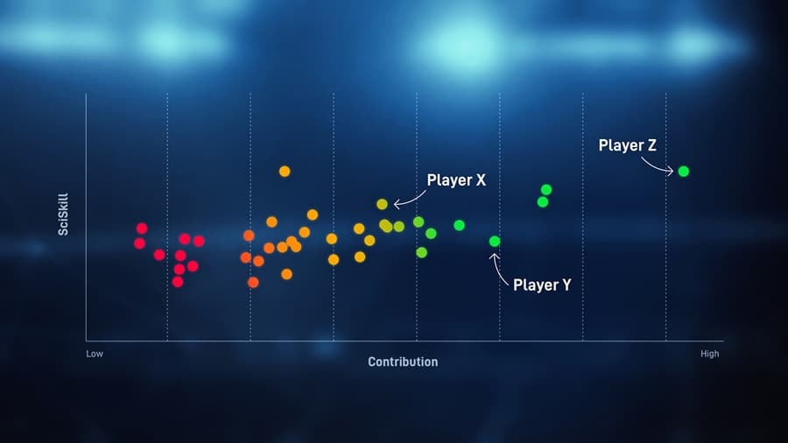
STATISTICS IN SPORTS
Graph databases fit well
Complex data in an easy structure
Used to maximize quality for analysis
EVENT TYPES:
Player can move from a league to another
Players can fill different positions in the squad
Players can get injured
Data Management
Carmignani Federico 1845479

Slide 8
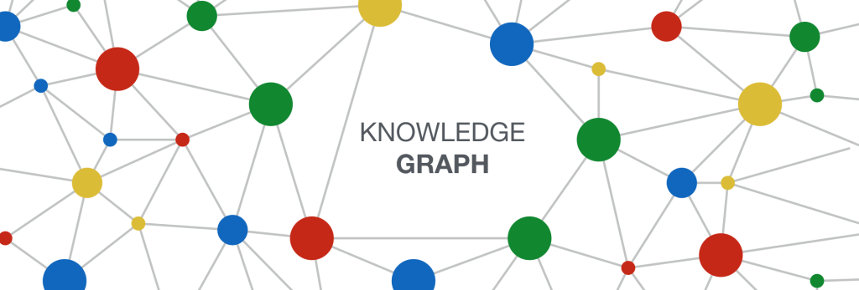
Hard to organize data in a scalable and transparent way
Graph-schema enables queries and aggregations not simple in a traditional data store (RDBMS).
Joins are costly whereas here it is possible to go from a relation to another in Constant Time.
Data Management
Carmignani Federico 1845479

Slide 9


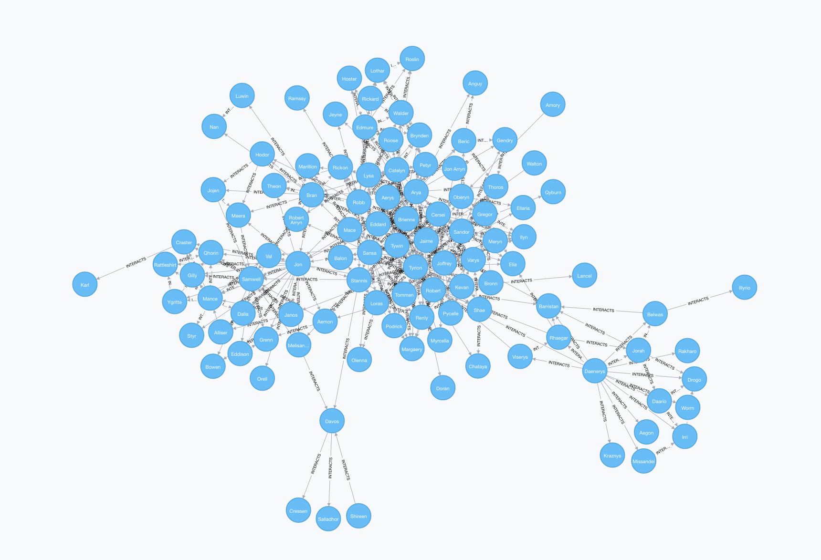
ADVANTAGES:
Has the player been used in the correct position during the match?
Which players played together in Serie A team AS Roma?
Complex queries
Add properties to each node and edge (relationships)
Pattern matching to find sequences (e.g. a sequence of actions leading to a goal)
Data Management
Carmignani Federico 1845479

Slide 10
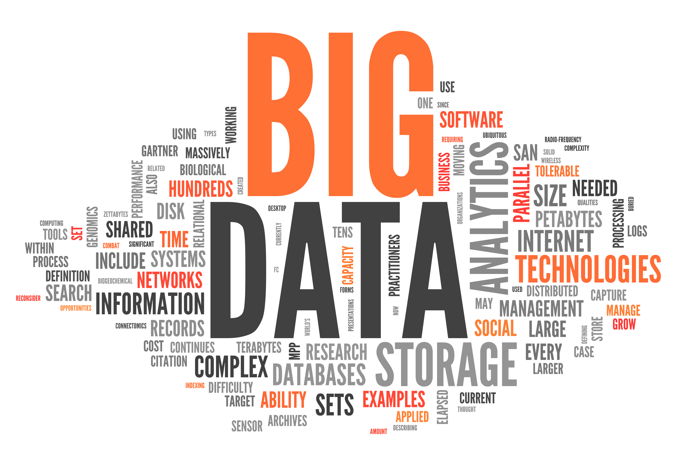
Date of birth
Height
It is possible to answer to:
«Players under 25 with the best winning rate in Serie A?»
Weight
Score
Flexibility
Power
Complex questions involving relationships with every aspect of the data
Data Management
Carmignani Federico 1845479

Slide 11
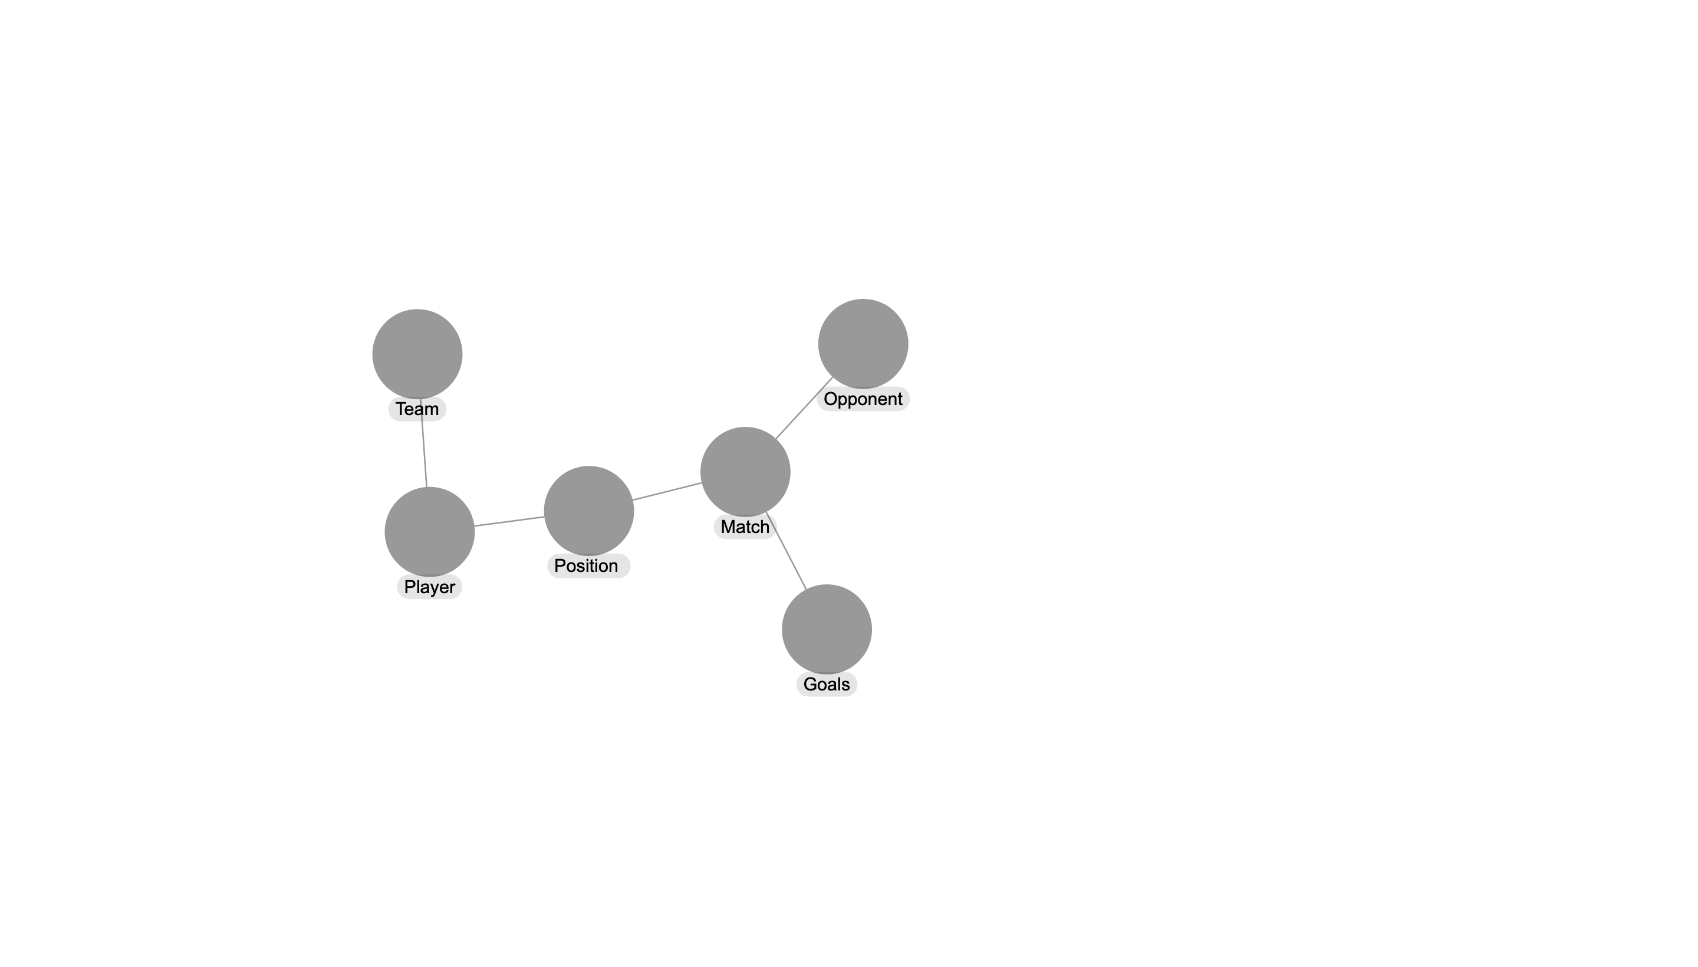
Let’s think on obtaining the players of a team
Constant Time in a Graph
But the schema can be deep
Player’s performance
Player’s opponents
Transformative and valuable
way for Sports Data: numbers and relationships
Data Management
Carmignani Federico 1845479

Slide 12
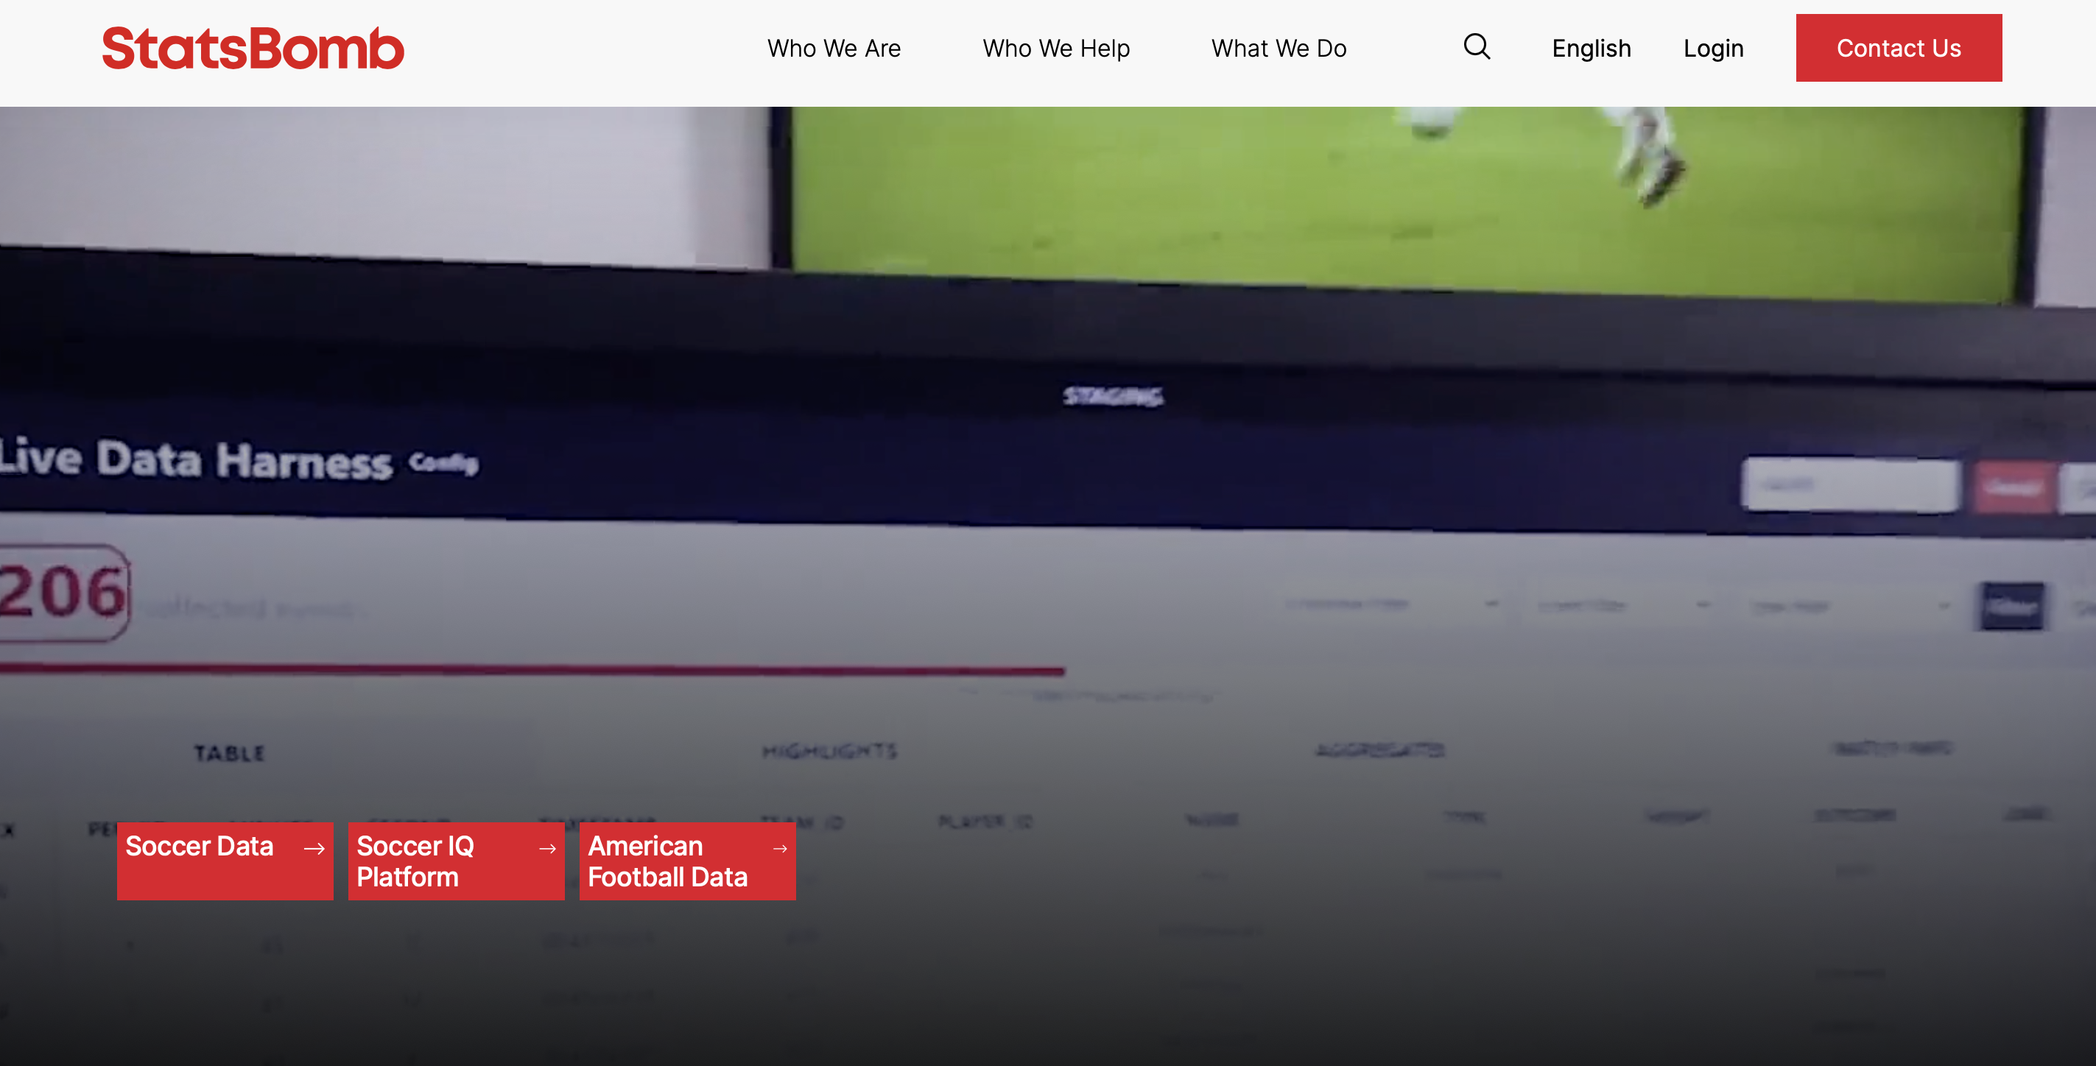
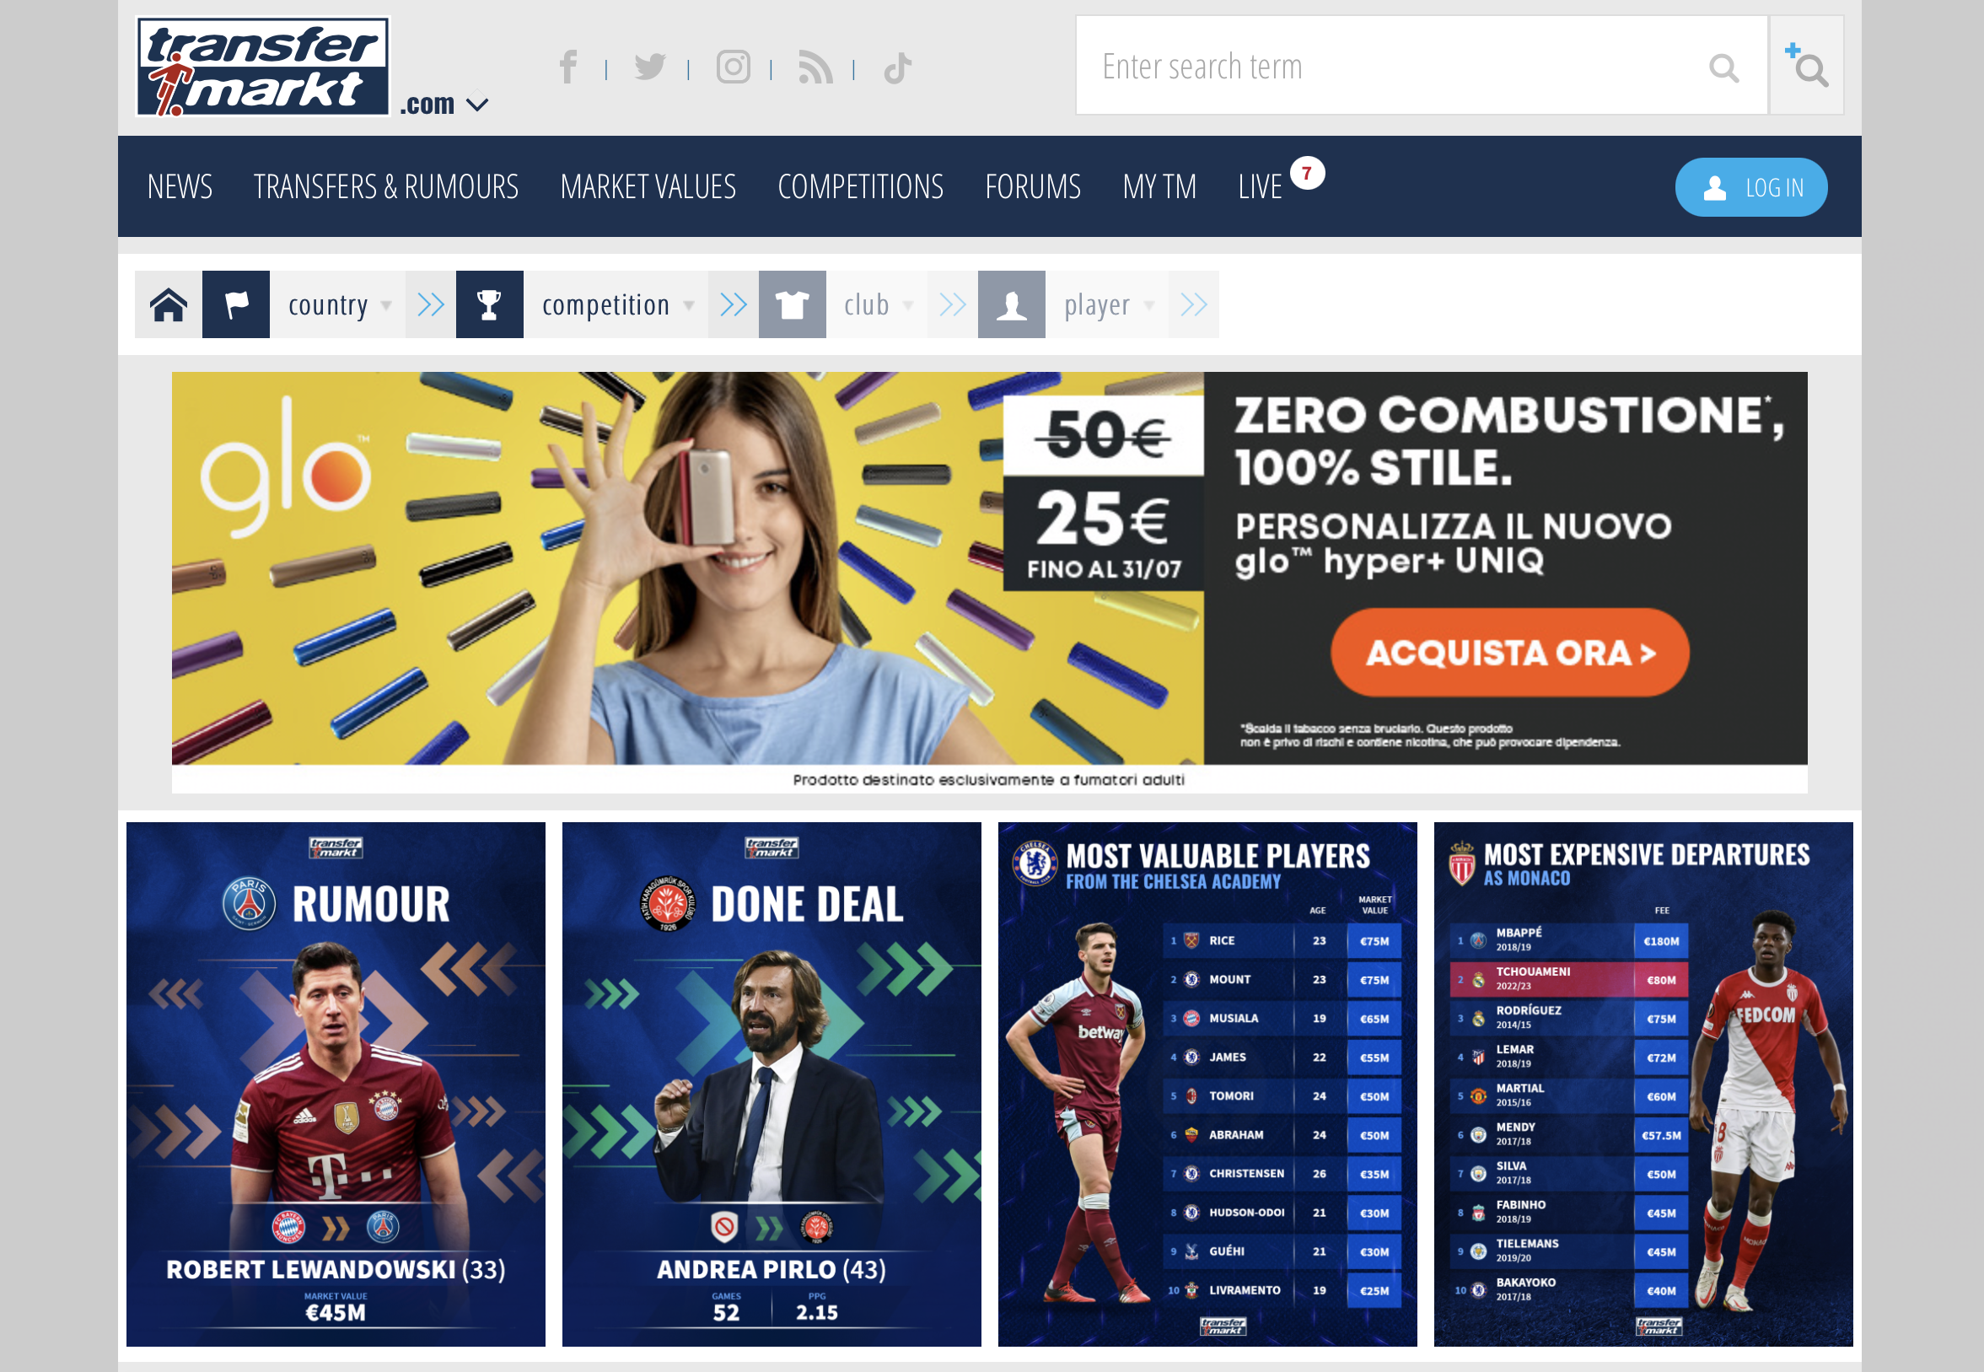
DATASET: COMPOSITION AND CONTENT
The dataset used in this project is composed of 2 main open-source (sub)datasets:
StatsBomb dataset
Transfermarkt dataset
Data Management
Carmignani Federico 1845479

Slide 13
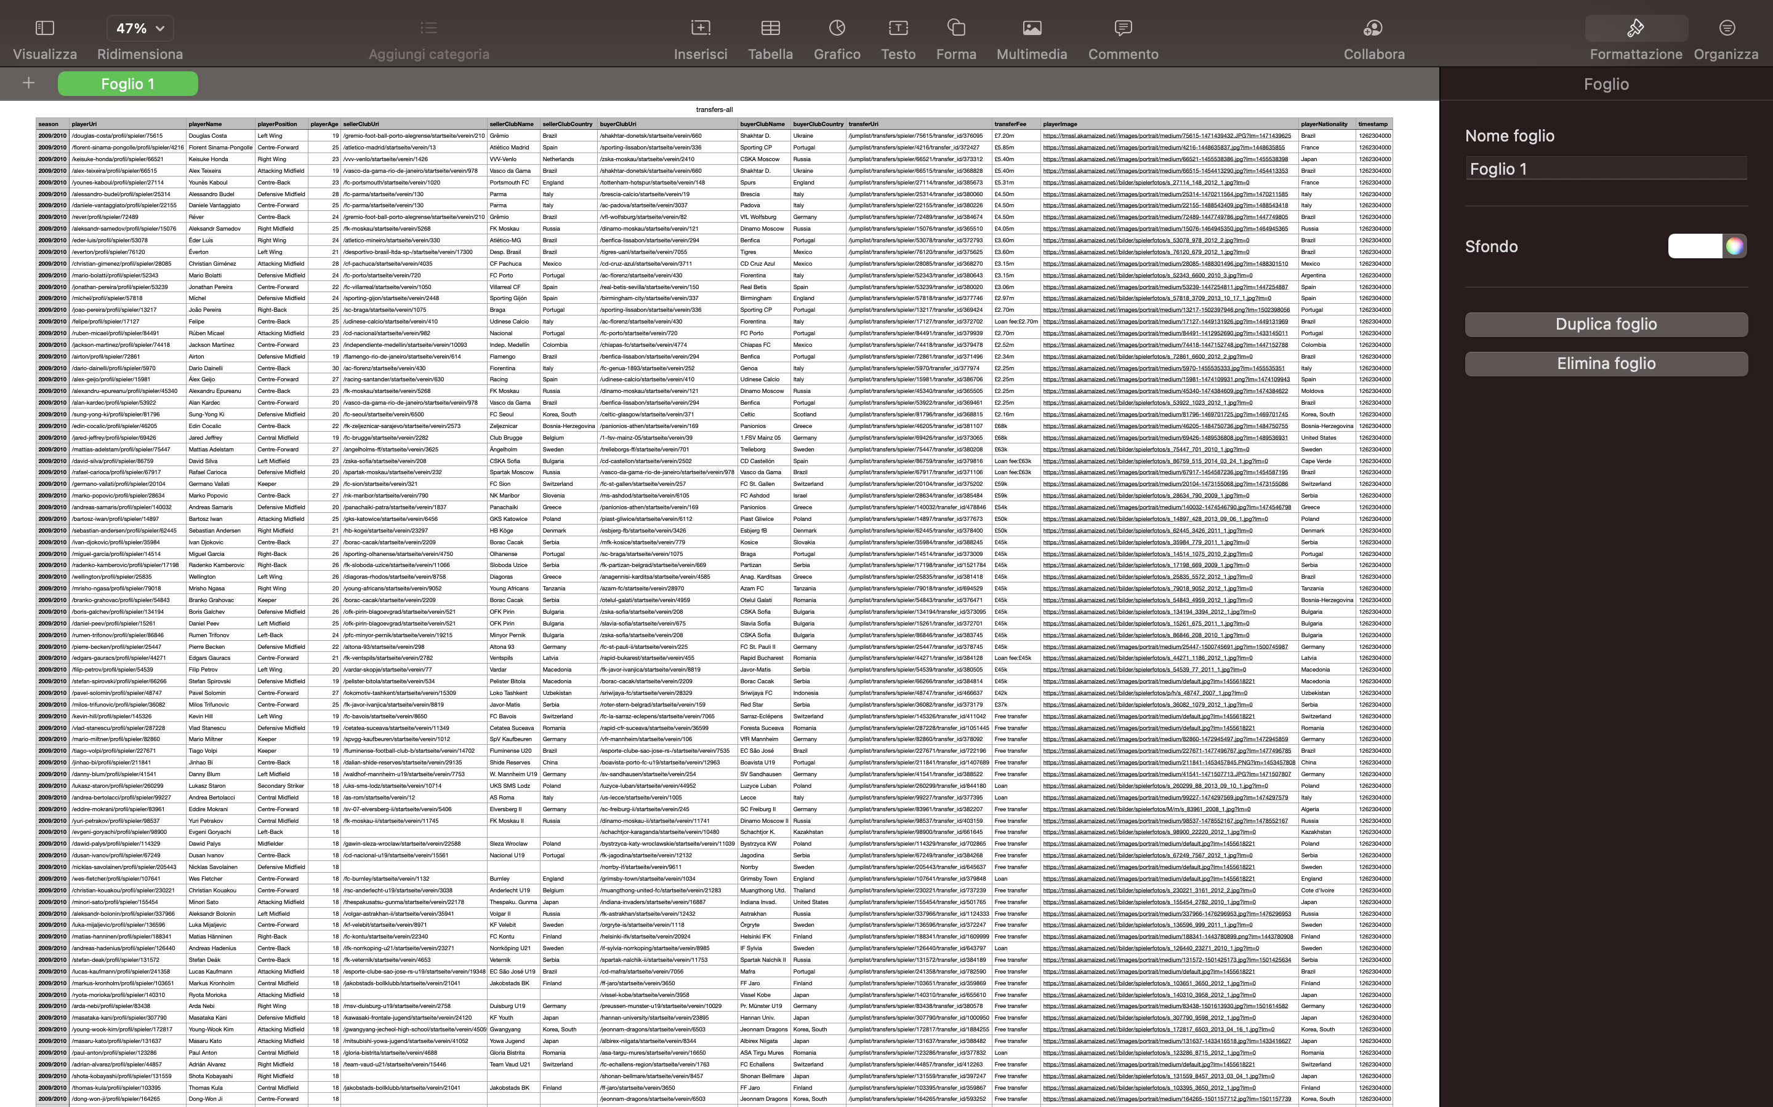
The goal is to import and analyse football transfers.
A bunch of transfers has been inserted into a CSV file to make practice with this dataset.
It is possible to retrieve it using the following URL:
https://s3-eu-west-1.amazonaws.com/football-transfers.neo4j.com/transfers-all.csv
Data Management
Carmignani Federico 1845479

Slide 14
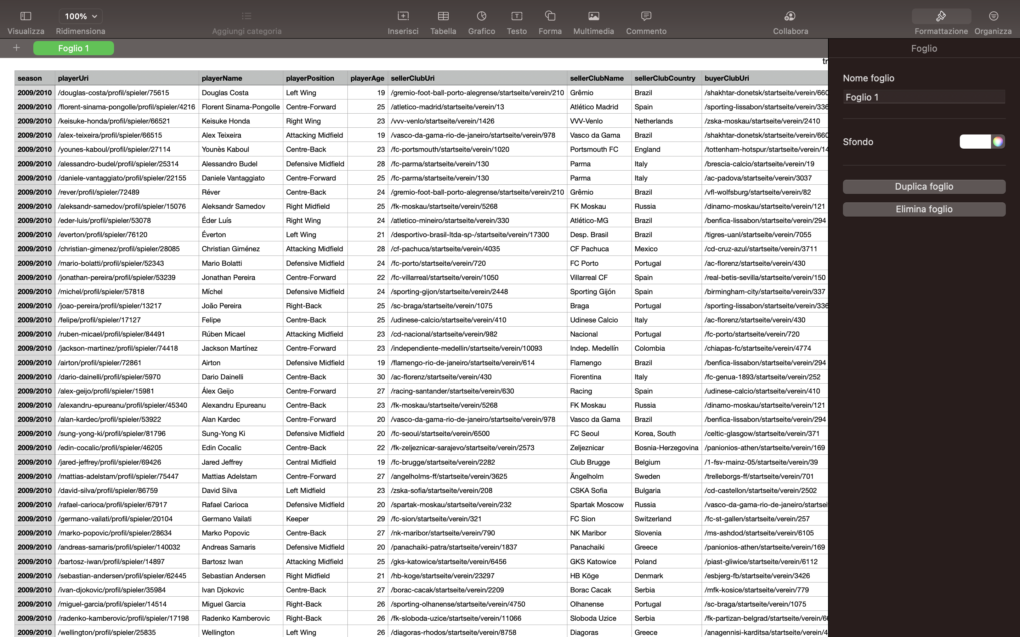
Transfermarkt dataset structure as a CSV file:

Slide 15
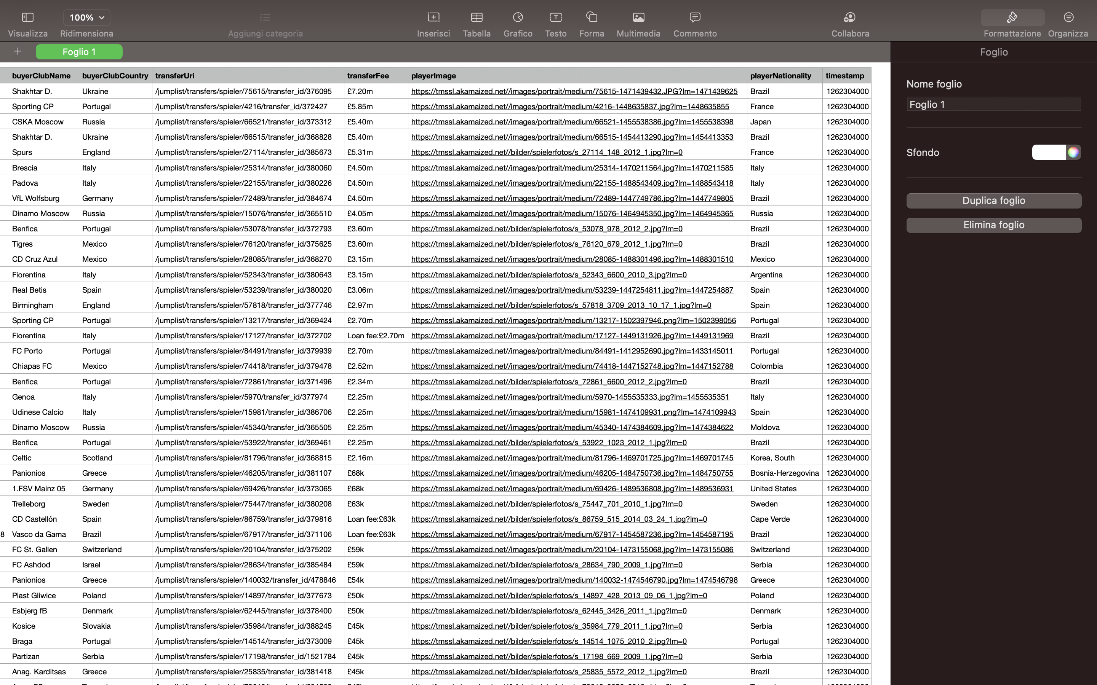
Transfermarkt dataset structure as a CSV file:

Slide 16

StatsBomb are committed to sharing new data and research publicly to enhance understanding of the game of Football. They want to actively encourage new research and analysis at all levels, making certain leagues of StatsBomb Data freely available for public use for research projects and genuine interest in football analytics.
The data is provided as JSON files exported from the StatsBomb Data API, in the following structure:
Competition and seasons stored in competitions.json.
Matches for each competition and season, stored in matches.
Each folder within is named for a competition ID, each file is named for a season ID within that competition.
Events and lineups for each match, stored in events and lineups respectively.
Each file is named for a match ID.
StatsBomb 360 data for selected matches, stored in three-sixty.
Each file is named for a match ID.
Some documentation about the meaning of different events and the format of the JSON can be found in the doc directory.
Data Management
Carmignani Federico 1845479

Slide 17
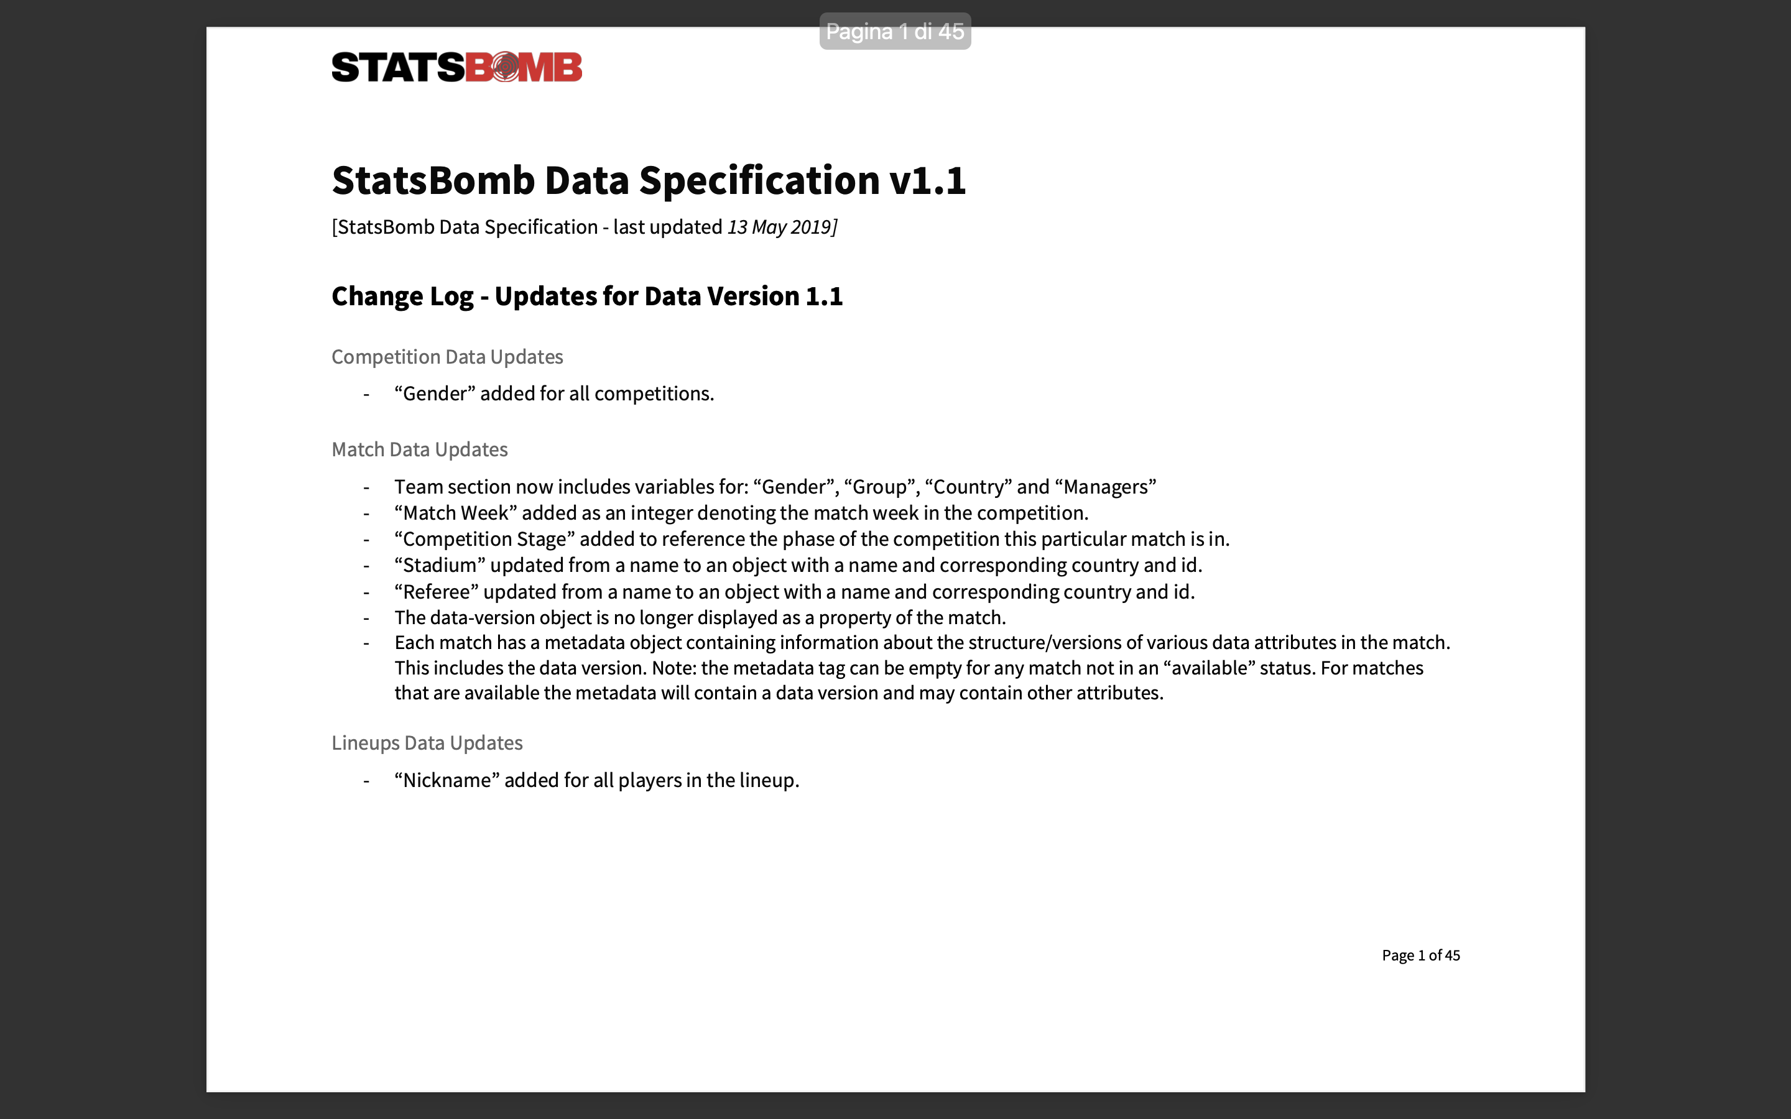
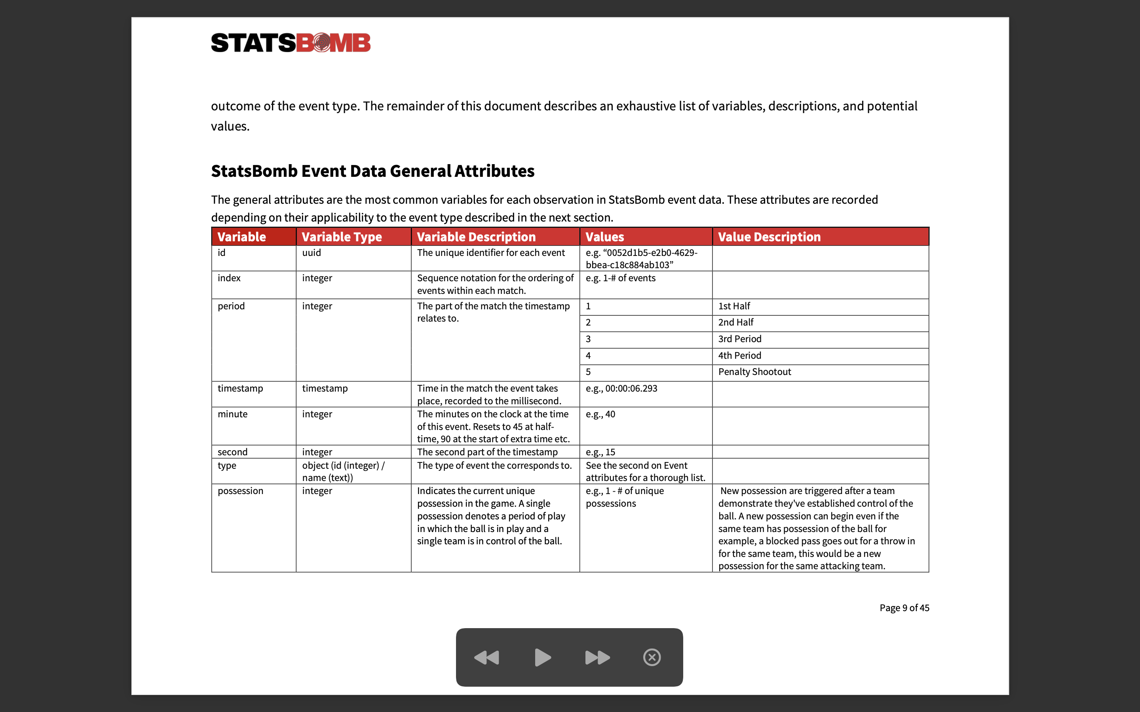
StatsBomb open-source dataset at: https://github.com/statsbomb/open-data
Data Management
Carmignani Federico 1845479

Slide 18
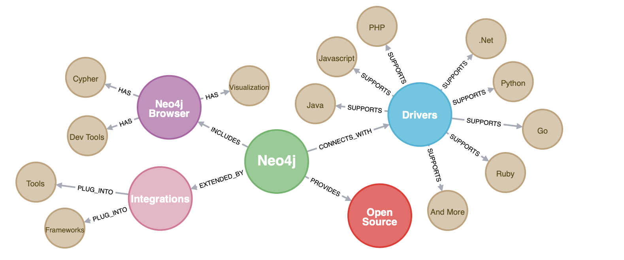
TOOL: NEO4J and ITS USAGE
Data Management
Carmignani Federico 1845479

Slide 19
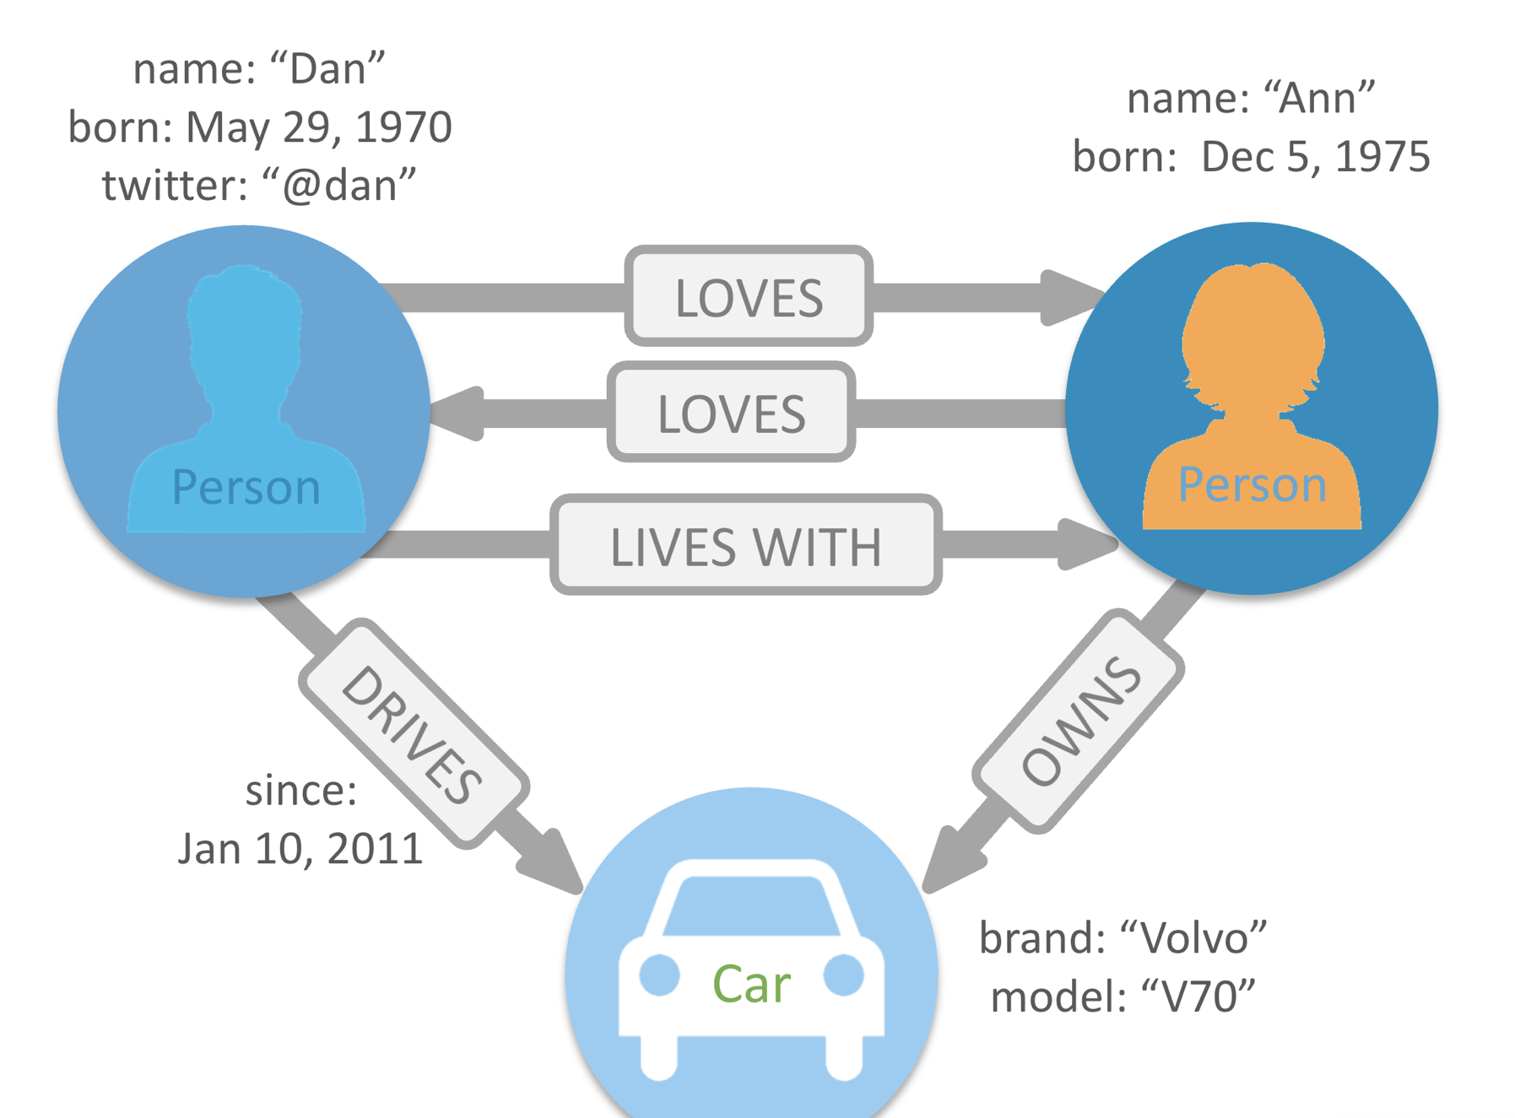
Neo4j: an open-source software for NoSQL databases developed in Java.
A new Data model: Graph-based model.
The reason to use it is to store, handle and query
highly-connected data in a data model based
on Graphs.
Native graph database processing and storage.
Transactional based on folders to memorize data.
Stand-alone and integrated in applications.
Nodes: entities
Edges: relationships
Properties: [attribute, value]
Data Management
Carmignani Federico 1845479

Slide 20
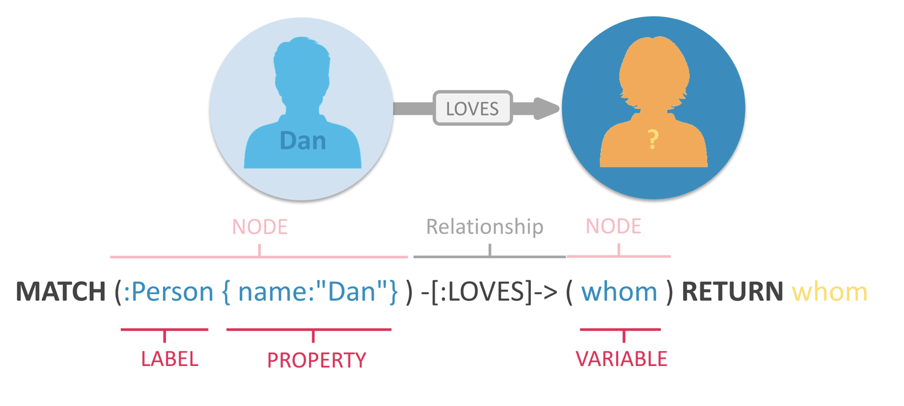
Create Graphs (also importing Data from external sources such as CSV or RDB).
Query Graphs with Cipher.
Data Science-driven analysis on Neo4j-Graphs.
Administration of Graphs in Production and Deployment (e.g. Docker or in the cloud).
CIPHER:
A next generation query language: human-friendly declarative language for graph patterns based on
the power of SQL but optimized for Graphs following CRUD operations.
Navigate deep hierarchies,
Find hidden connections between distant items, and
Discover inter-relationships between items.
More info at: https://neo4j.com/developer/cypher/
Data Management
Carmignani Federico 1845479

Slide 21
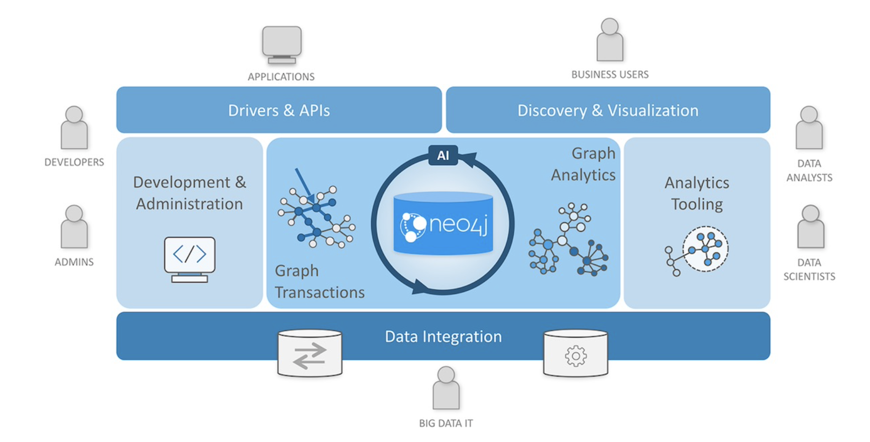
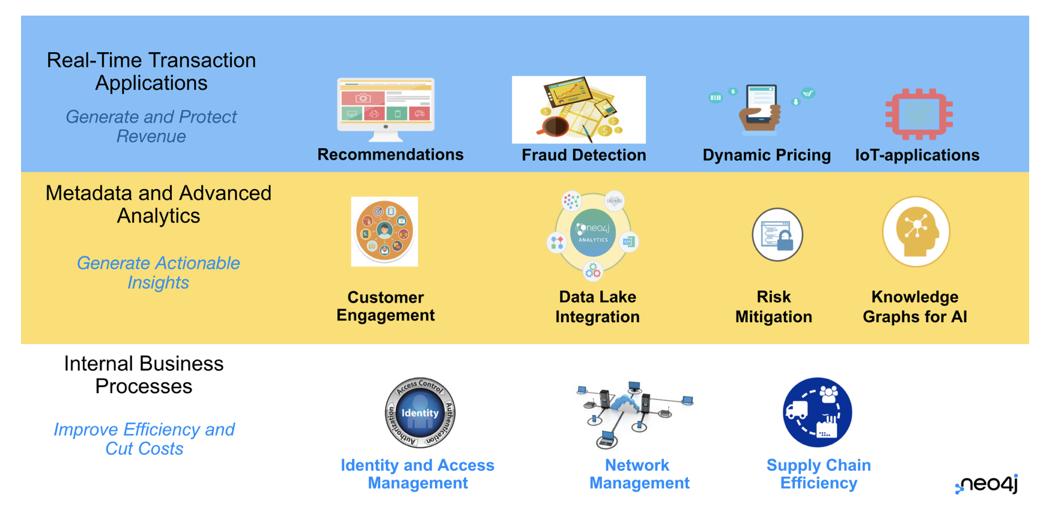
Neo4j Graph Database - our core graph database that is built to store and retrieve connected data. There are two editions - a Community Edition and an Enterprise Edition. Everything in the platform interacts with data stored in the database.
Neo4j Desktop - application to manage local instances of Neo4j.
Neo4j Browser - online browser interface to query and view the data in the database. Basic visualization capabilities using Cypher query language.
Neo4j Bloom - visualization tool for business users that does not require any code or programming skills to view and analyze data.
Data Management
Carmignani Federico 1845479

Slide 22
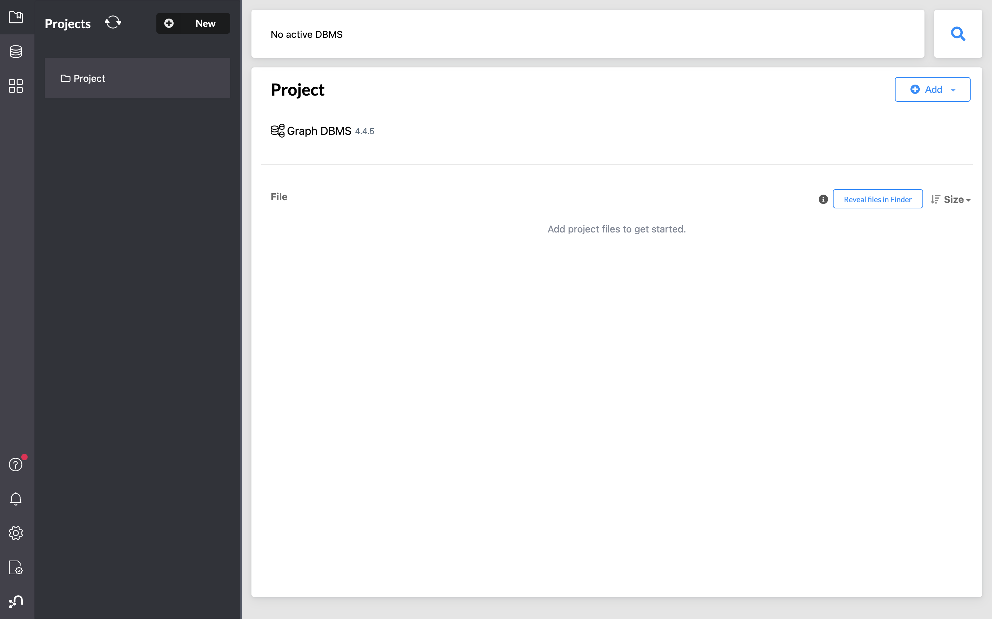
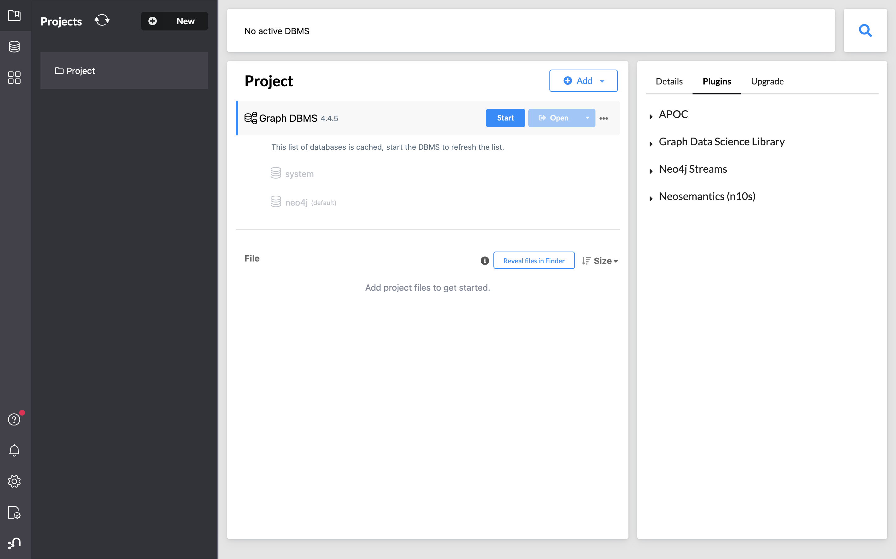
Neo4j Desktop:
Data Management
Carmignani Federico 1845479

Slide 23
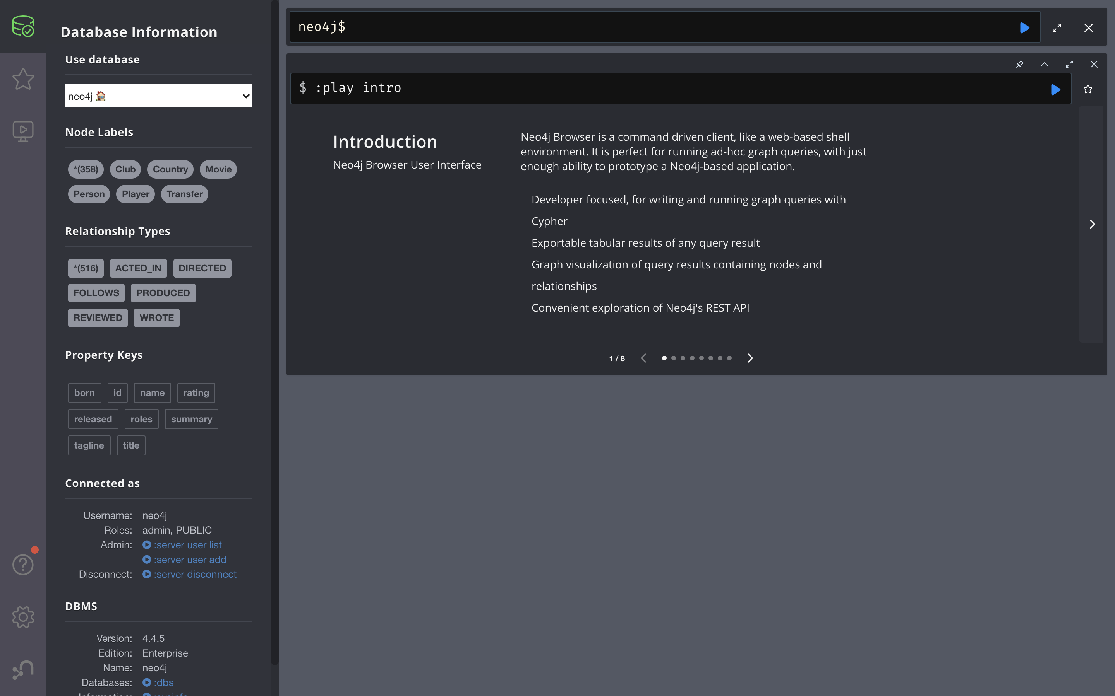
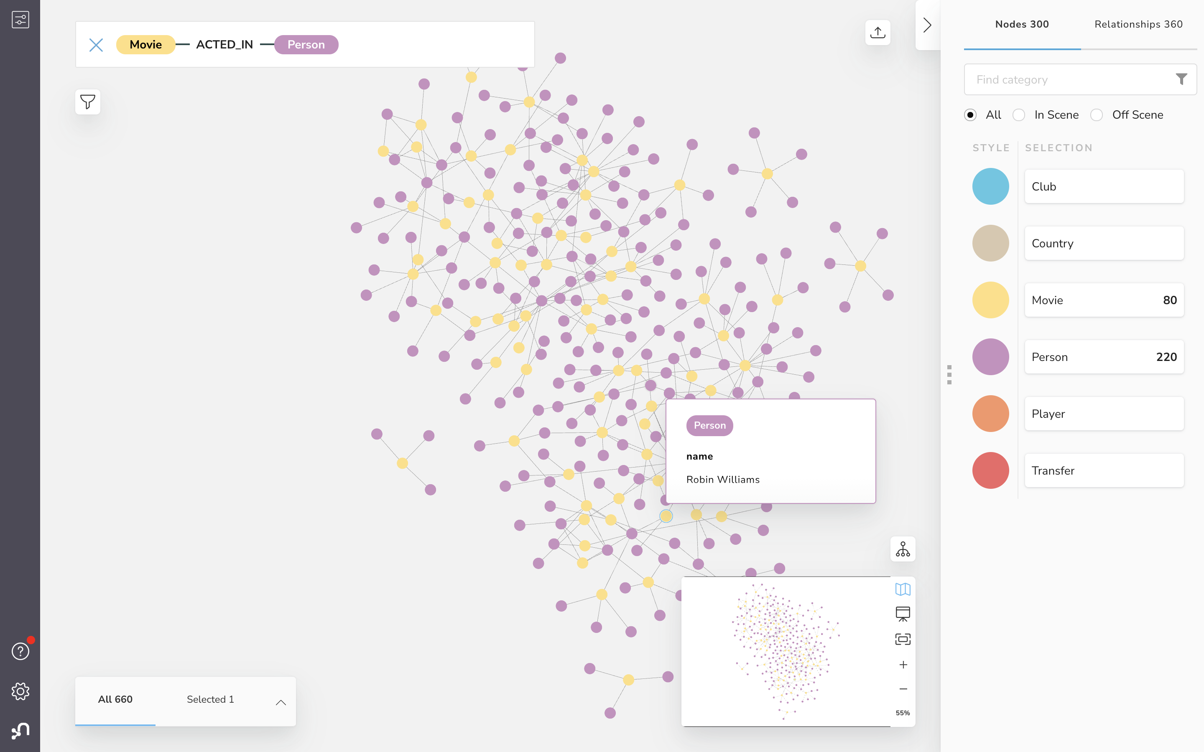
Neo4j Browser and Neo4j Bloom:
Data Management
Carmignani Federico 1845479

Slide 24
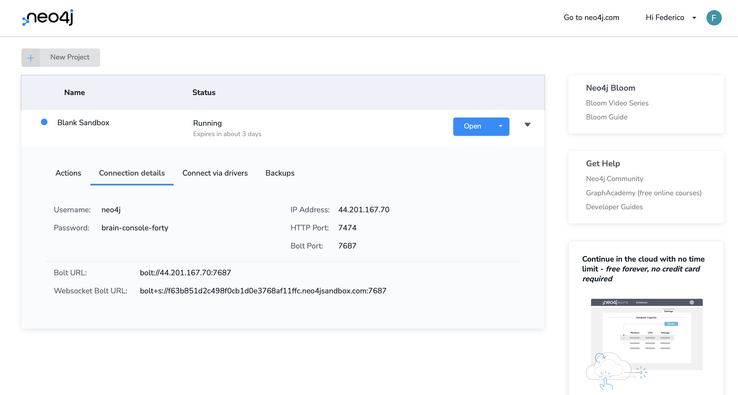
I will use a Python Notebook through Neo4j specific drivers to connect with it.
Neo4j Sandbox:
Then it can be added to the Neo4j Desktop as a remote database using the connection
details but I will use also a local database through the Neo4j Browser.
Data Management
Carmignani Federico 1845479

Slide 25
EXPERIMENTS
2 TASKS:
The idea is to use Neo4j in two tasks:
The first task related to a dataset of transfermarkt.com and, using the graph as a data model, to represent the transfers that took place in a certain year or with particular properties; then it is about to show queries that can be advantageous in a representation of this type.
The second task is instead to show how a graph can be exploited in match analysis: this consists in taking a dataset from statsbomb.com relating to the events of a single match and showing how the graph can be structured and then some useful queries.
In both tasks the nature of data are based on temporal sequences of events.
Graph databases (Neo4j) are suitable!
Data Management
Carmignani Federico 1845479

Slide 26
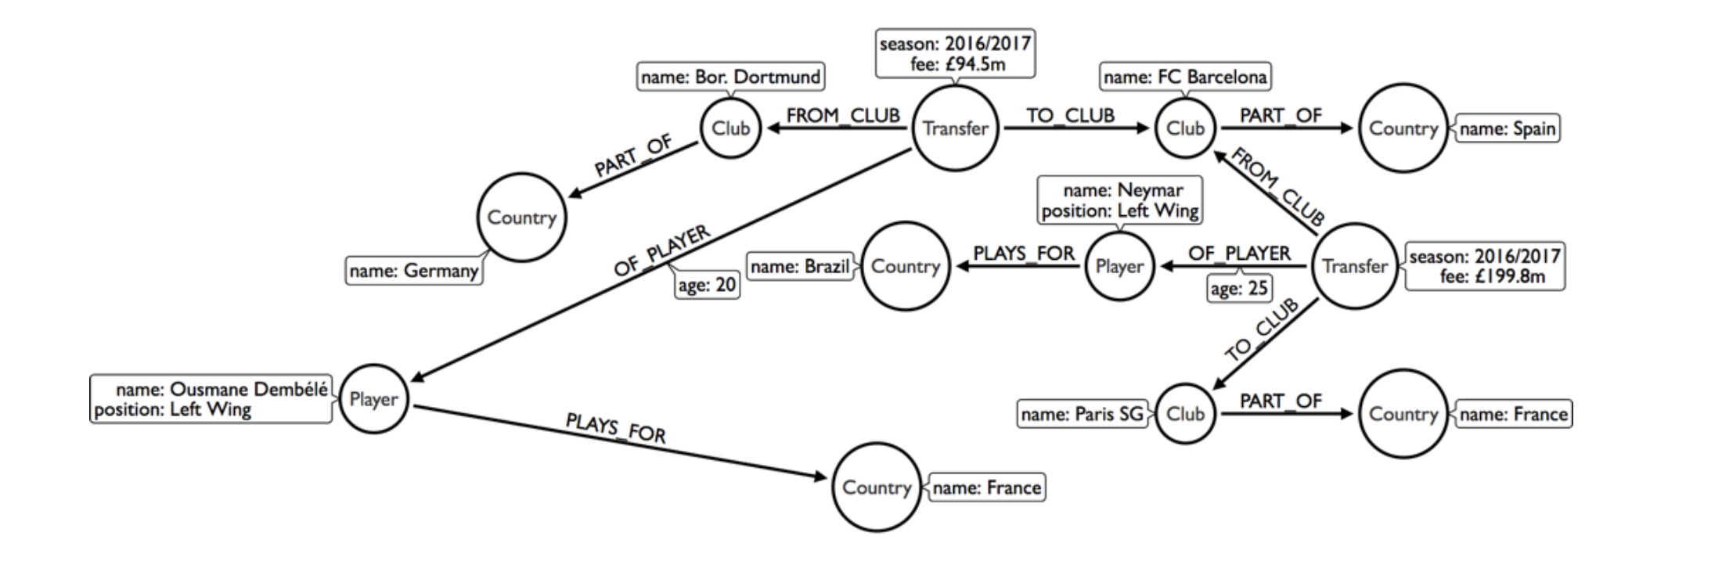
TASK 1: TRANSFERMARKT
Installation in Python (Pip3).
Driver for Neo4j: creation and query session.
Constraints setting and data loading.
Use of the usual pattern for query.
APOC functions for data cleaning and operations with strings.
Aggregation queries and path-based queries.
Other keywords used are: not exists, exists, starts with, ends with, case, when, end.
Some keywords used:
WITH
LOAD
ON CREATE SET
MATCH
WHERE
RETURN / MERGE
LIMIT
ORDER BY
Data Management
Carmignani Federico 1845479

Slide 27
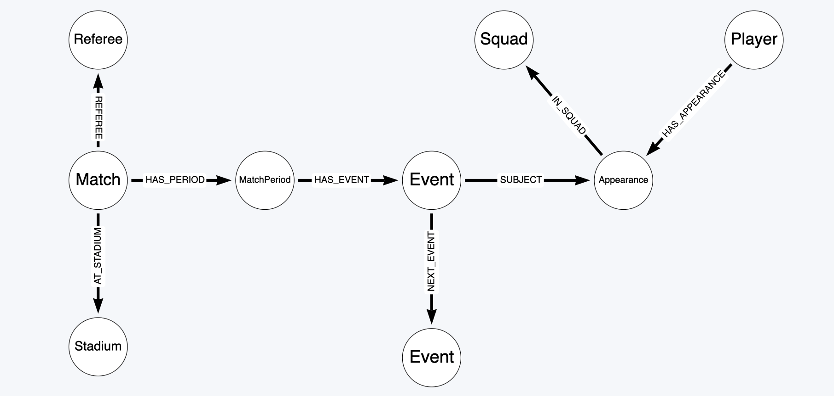
TASK 2: STATSBOMB
Creation of local database and installation of APOC library.
Browser initialization for query session.
Constraints setting and data loading: all JSON files are uploaded using APOC functions.
Competitions are created, each one with different Seasons.
Matches are created with informations like Referee and Stadium.
For a particular Match the Players and Squads are inserted.
For a particular Match Events are created and linked in a linked list in chronological order.
Many Event types are defined such as Pass, Goal, Shot etc.
Use of the usual pattern for query and path-based queries: football analysis application.
Data Management
Carmignani Federico 1845479

Slide 28

AND NOW A QUICK DEMO..
TASK 1:
Sandbox Graph on this dataset.
Simple and more complex queries on it with Python.
Neo4j Sandbox Environment and
Python Notebook
(IN CLOUD)
TASK 2:
How to create the local Graph on this dataset.
Simple and more complex queries on it.
Neo4j Desktop and Browser
(ON PREMISE)
Data Management
Carmignani Federico 1845479

Slide 29

CONCLUSIONS
POSSIBLE EXTENSIONS:
The idea to use Neo4j can be extended in different ways:
Integration in a real application.
Exploitation of the power of Cipher as Query Language and other external libraries.
Use of JavaScript frameworks (D3.js) for Data Analysis to visualize dynamically the Graphs.
Use of a greater size for the Datasets, also adding ETL operations.
Data Management
Carmignani Federico 1845479

Slide 30
Master’s Degree in Engineering in Computer Science Sapienza University of Rome Academic Year 2021-2022
Thank you for your attention!
Course: Data Management
Professor: Prof. Lenzerini Maurizio
Candidate: Carmignani Federico
ID number: 1845479
E-mail: carmignani.1845479@studenti.uniroma1.it

